Slide 1
Java Workshop 6 Introduction to Object Oriented Programming (OOP)
OOP used well is OP
Ben Schwarz

Slide 2
Lesson Outline
OOP is a huge topic, it will take a long time to get used to, but it is very important.
Procedural Programming vs Object Oriented Programming
Data Structure – Class
Objects

Slide 3
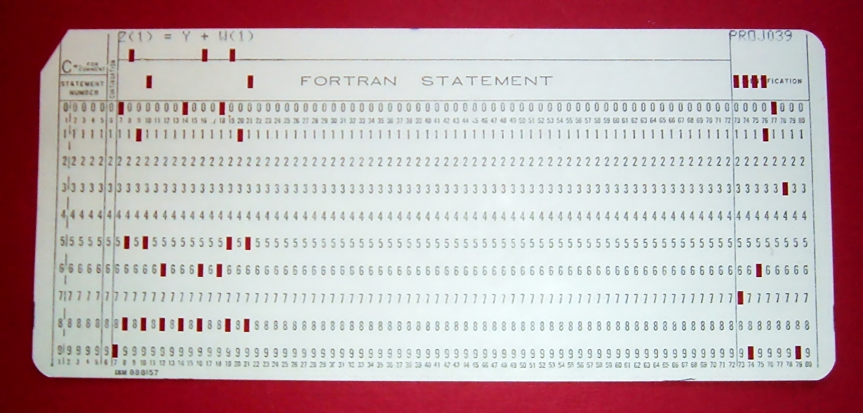
Data before action (OOP) vs action before Data (Procedural programming)
In procedural programming we think in terms of functions and then as a secondary matter the data on which the functions act upon.
In Objected oriented we reverse that, we come up with data types first and then decide what operations we need associated with these data types.
This means that unlike other programming languages (FORTRAN) that focus on giving the computer imperative “Do This then Do That” commands, it focuses on data
This means that rather then scrapping code and doing something else every time we have to do something new, we can “Recycle” and build upon code that we have, or someone else has, already written.
FORTRAN

Slide 4
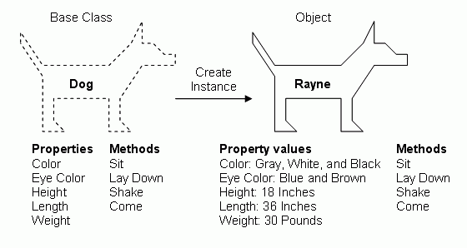
Classes and Objects
In object-oriented languages, you use objects and classes to organise your code to take advantage of this programming concept
What are objects and classes you say?

Slide 5
What are classes and objects
Pretend you are writing a java program that has to keep track of a book production facility
Every book produced only differs slightly from the next one, being in page-size, font-size, line-height, author name etc. Within an object-oriented computer program, every book is an object
But objects aren’t everything, although the books all differ slightly from each other in some way, they all share the exact same characteristics. In an object-oriented program we need a master list that contains every characteristic a book object can have. This master list is called a class
A class could also be seen as a blueprint for the building of a book. It contains all of the book’s characteristics on a page. Where the blueprint says that every book produced will have a “page-size”, the actual book will have page size A5.
It doesn’t just stop at characteristics though – a year after you make this book blueprint, you could have used it to produce a million other books
If you don’t understand the analogy here is the summary:
A programmer first writes code to describe a class (Book Blueprint) (I.e. Describe the data)
Once the program runs, the computer creates objects (Books) from the (Blueprint) class
Analogy inspired by “Java for Dummies 6th Edition”

Slide 6
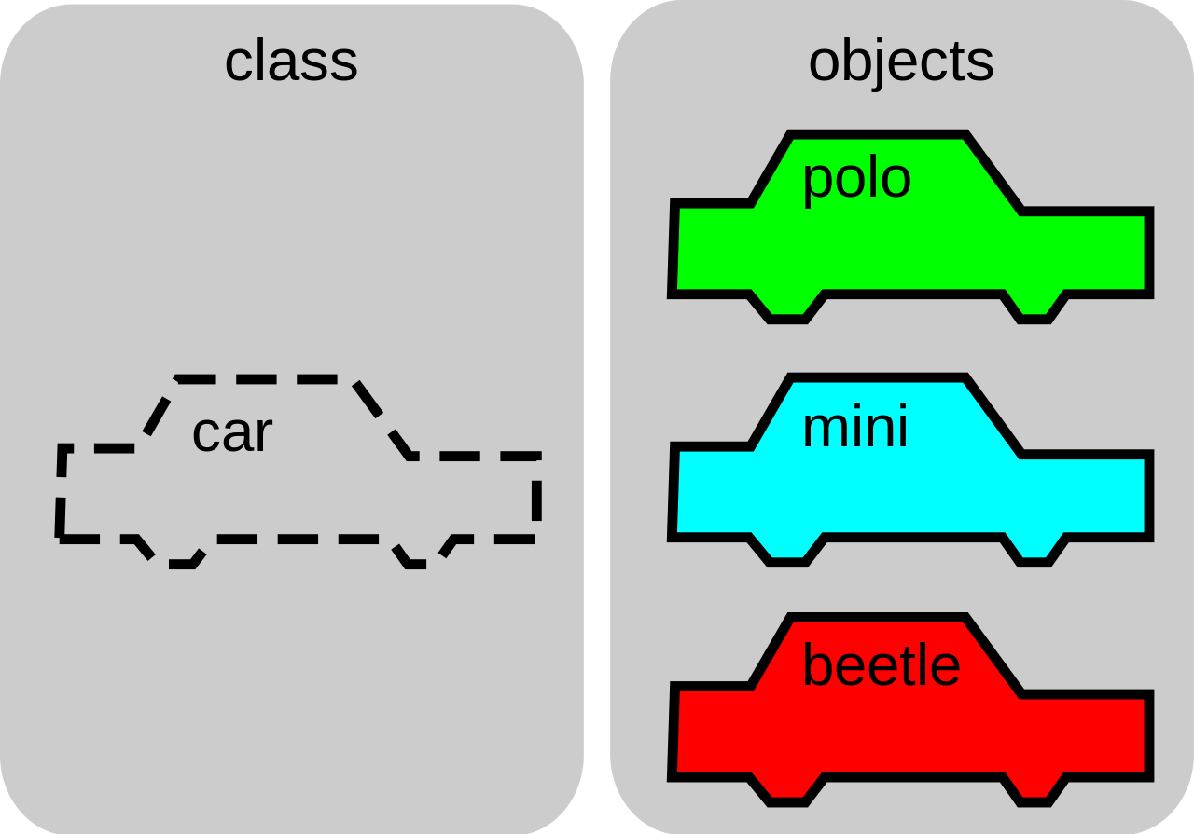
Lesson 6: OOP
This might be terribly confusing for some of you, so if you have any questions ask them now

Slide 7
Parts to a complex data type
Classes are compound data types – They consist of other data types.
They contain methods for acting on those data types.
Fields (data member)
Methods (function member)

Slide 8
Object-Oriented Programming
OOP operates around the use of objects, which store data, and have methods to act on that data.
Say that there wasn’t an existing data structure to hold the information about a date. We could hold three variables for each date we worked with, making our code unreadable, or we could make our own data type.
Date Data Structure
Properties/Attributes:
int day
int month
int year
Methods:
int getDayOfWeek()
boolean isBefore(Date d)
Date add(Date d)
Date subtract(Date d)

Slide 9

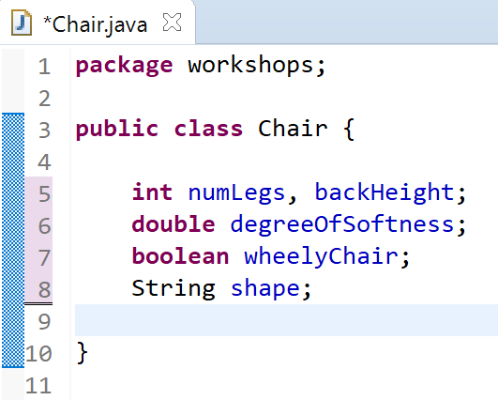
Creating a Chair class
To first create an object we need a class to instantiate, in this case – we will create a Chair class, in which we will make a blueprint for a chair.
Once we have done that we need to give the Chair class attributes, lay out the characteristics that all chairs have
This is, in essence, what it means to be a chair
Each of these variables make up a chair. As these variables are a part of an object, we call each of them a field
This code may bring with it the realisation of what classes and objects are, especially if you have been grappling with what I told you in the theory.
Remember to not to have a main method in the chair class.
Can you really create a class this easily? Yes. Yes you can.

Slide 10
Exercises – Now do this for the Date Class
On your own, you now need to create a Date class
You need to add the fields, but ignore the methods for now
Date Data Structure
Properties/Attributes:
int day
int month
int year
Methods:
int getDayOfWeek()
boolean isBefore(Date d)
Date add(Date d)
Date subtract(Date d)

Slide 11
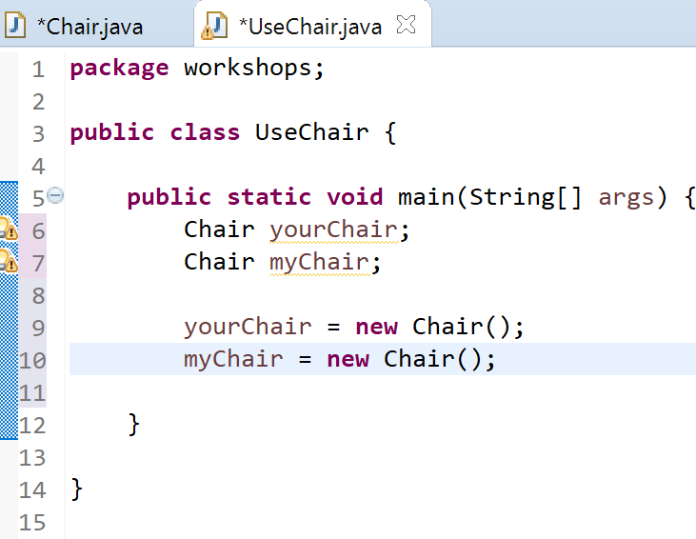
Utilising the class
We want to be able to interact with a chair now right? So create a new class called UseChair with a main method.
Within the UseChair class’ main method, create a new instance of a chair.
When we create an object, we say it is an instance of the Class.

Slide 12
Creating an object
Some read this first line as meaning, “yourChair is a chair” but that’s not what it means
In this first line we are instead declaring an object to exist, we haven't actually made it yet. All this does is reserve variable name yourChair so that it can eventually refer to an instance of the Chair class
The creation of the objects for official use don’t come until we execute the lines below
Object type
Object/variable name

Slide 13
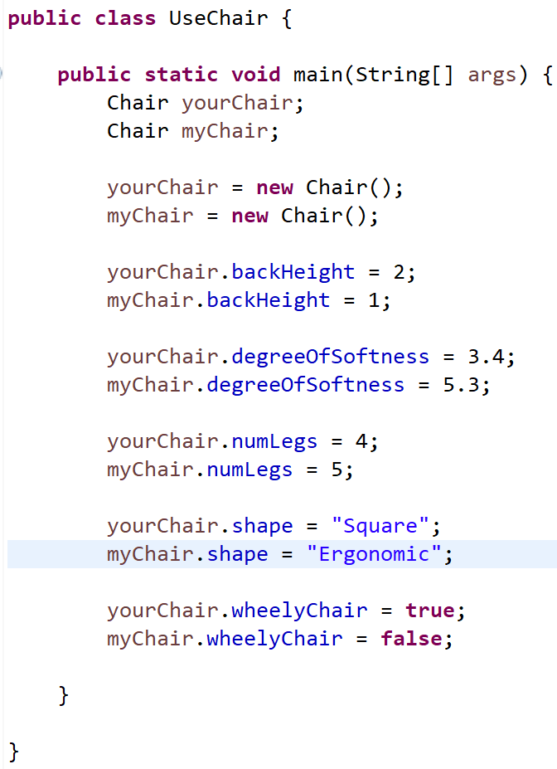
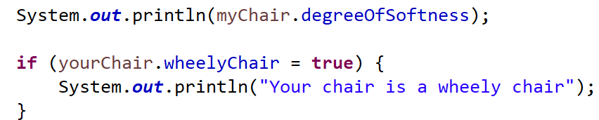
Using an object
Once we have created the two Chair objects, we can then change the values of the characteristics of the chair by doing the following –
As you can see in my code so far I am accessing fields of each chair object, and am setting them to values
We can also use these fields to do different things
For example, we can print the values of each field, or use them as the condition of an if statement

Slide 14

Note
Just like we could declare a primitive data type variable (int, char, boolean etc.) by stating what is below we do the same thing with objects. It is the same but different

Slide 15
Now do the same thing with the date class
Create a Date object with the name today.
Set it’s values
Print out the values by getting them from the Date object.
Accessing properties:
varName.propertyName;

Slide 16
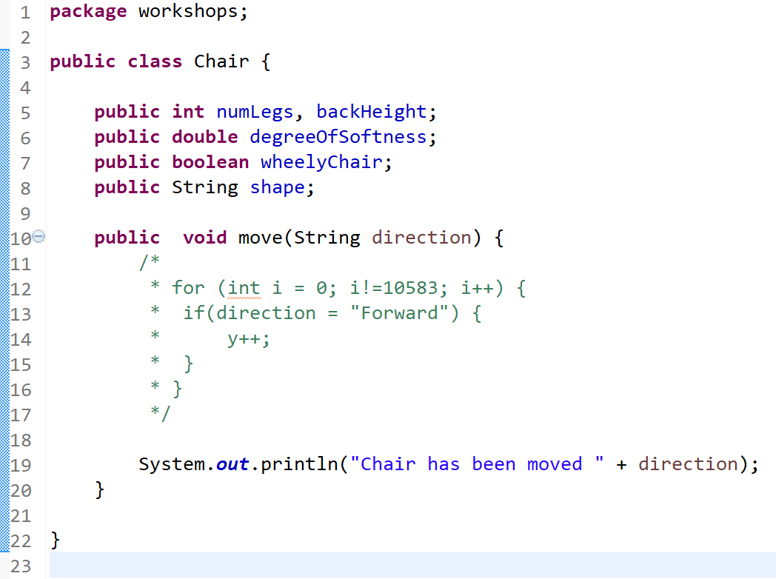

Methods in classes
Do you all remember methods from the other lesson? They are a set of instructions that do things, and because of their modularity, they can be used in loops to perform instructions over and over again, and can simply clean up your code so it is easier to read
An important distinction to note between fields and methods, is that each instance of a class has it’s own copy of the class's fields. Whereas for methods, there is only one copy in memory and when it is called the instance passes itself into the method.

Slide 17
Static
Makes a variable or function the same throughout every instance of the class – it is not specific to a certain object. If changed it affects all objects of it’s type. For e.g. if you wanted all chair objects to know how many chairs there are you could have a static integer and add 1 to it every time a chair is created.
Say you want to keep track of batting averages for a team of baseball player objects. You could have a static average which they can all contribute to.

Slide 18
Now do the same thing with the date class
Create the Boolean isBefore Method
Create a second Date object
Compare the two Dates using this method and print the Boolean result
Extension:
Create the getDayOfWeek() Method (You will probably have to google a formula)
Date Data Structure
Properties/Attributes:
int day
int month
int year
Methods:
int getDayOfWeek()
boolean isBefore(Date d)
Date add(Date d)
Date subtract(Date d)

Slide 19
Constructors
Here is a statement that creates a chair object
We know that we are adding Chair data to the variable names yourChair and myChair, or, we are using the constructor of the Chair class to create a new object. Well, what does this mean?
When we ask the computer to create a new object, it finds memory in which to store the object and its characteristics, or fields
A question you might have is, when I create a new object, can I control what’s placed in the object’s fields as well? What if I want to do more then just fill fields, say, whenever a Chair object is created, I want it to carry out a whole list of other jobs
I am going to tell you about constructors
If you didn’t get that, A constructor tells the computer to perform the start-up tasks of a new object
A constructor is a method that runs when the object is instantiated.

Slide 20
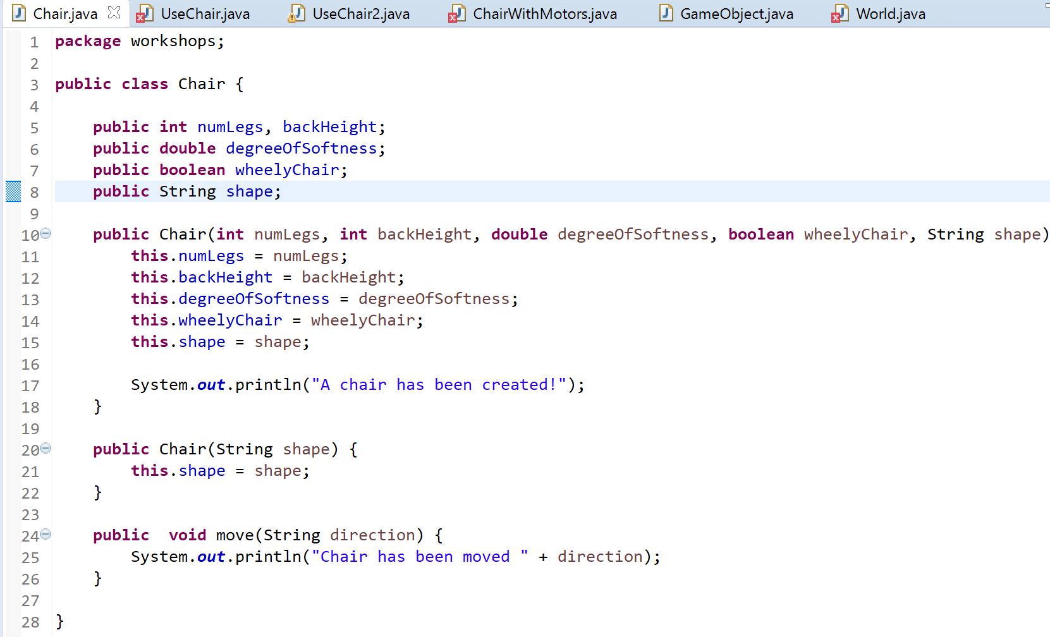
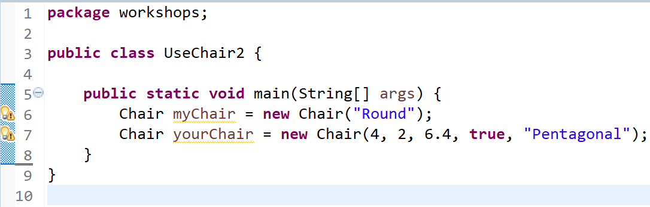
Creating Constructors
Here we can see method-like things that have the name Chair, the same name as the class
These are called constructors
Inside the constructors we are setting the values of the object in its setup, rather then doing it manually ourselves
We can have multiple constructors with different parameters and the same name, but dependant on what parameters we put in the constructor when we make the object, it uses a different constructor
For example, if I were to make a Chair using only a String as the parameter, it would create the object but only with its shape field specified. But if I were to use all the fields in the constructor parameters, it would set all the fields in the new chair object to something
*Remember “this.”, it refers to the instance of the class.

Slide 21
This
The keyword this was touched on earlier but here is another slightly more in depth explanation.
Compare the word to the English phrase “state your name”
I, (state your name) do solemnly swear, to uphold the constitution of the Philadelphia Central High School Photography Society…
The phrase “state your name” is a placeholder. A space in which each person puts their name. E.g. I Bobby Tales, do solemnly swear…
Think of the pledge as a piece of code in a java class. Whenever an instance of the class (a person) executes the code (takes the pledge) the instance fills their own name (that is the object they are) in place of the phrase.
This is very helpful

Slide 22
Now do the same thing with the date class
Create a Date constructor with parameters day, month and year.
Date Data Structure
Properties/Attributes:
int day
int month
int year
Methods:
int getDayOfWeek()
boolean isBefore(Date d)
Date add(Date d)
Date subtract(Date d)

Slide 23
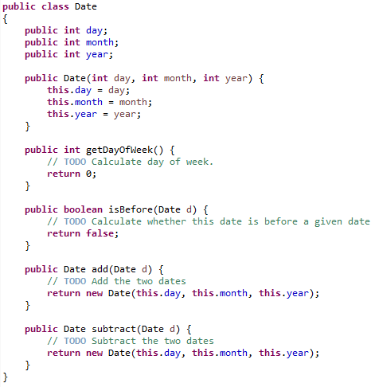
Creating a Data Structure
Properties (Fields)
Date Data Structure
Properties/Attributes:
int day
int month
int year
Methods:
int getDayOfWeek()
boolean isBefore(Date d)
Date add(Date d)
Date subtract(Date d)
Constructor
Methods

Slide 24


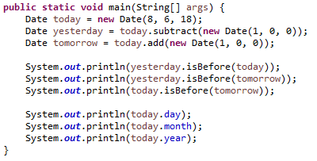
Syntax Overview - Objects
We’ve seen objects used as Strings and ArrayLists. Here the syntax is the same. An object of the Date type is called an instance of the Date class
Creation:
Datatype varName = new Datatype(params);
Accessing properties:
varName.propertyName;
Calling methods:
varName.methodName(params);

Slide 25
Your Turn
Create a Time data structure, described on the right. Your methods should all be functional, and all information in the data structure should be public.
Remember to handle the following edge cases:
Negative hour/minute
Hour/minute past maximum values
The equality case for isBefore()
Extension: Continue the DayofWeek Method from before. If stuck - https://cs.uwaterloo.ca/~alopez-o/math-faq/node73.html
Time Data Structure
Properties/Attributes:
int hour
int minute
Methods:
boolean isAfternoon()
boolean isBefore(Time t)
Time add(Time t)
Time subtract(Time t)

Slide 26
Summary
OOP is a huge topic, and so we are splitting it up into smaller sections.
This is part 1, next week will be part 2, which covers inheritance and encapsulation.
You should now be able to:
Understand the purpose of OOP in simplifying code that handles groups of data.
Create a simple data structure class
Use created objects
Recognise what an instance of a class means

